Slide 1
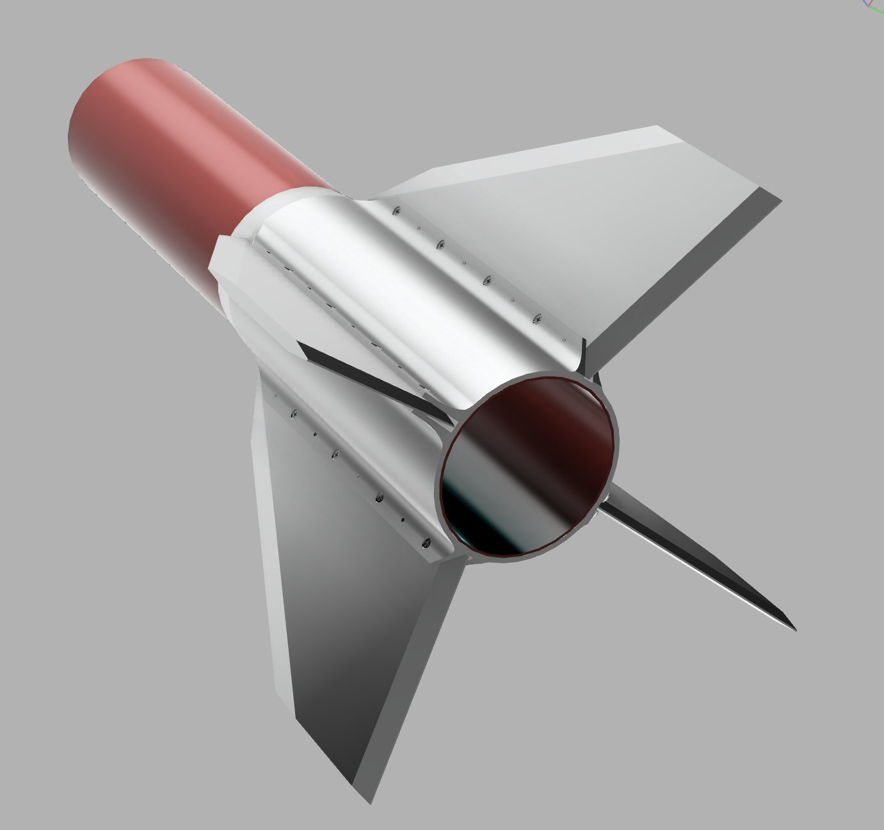
AIRFRAME PROGRES REPORT
WEEK 4
06-02-2023

Slide 2
OVERVIEW
Parachute Testing
Fin Fabrication
Complete airframe model

Slide 3
PARACHUTE TESTING
Tests were conducted with the actual parachute.
Weight loads used were 7.8 kgs, 3.3 kgs (Stones wrapped in a bag)
Tests with the 7.8 kgs had the parachute not deploying
Tests with the 3.3 kgs successfully deployed but didn't the height was not enough
Resolved to scale down the parachute size 1 m diameter (Under fabrication)
Testing kicked off successfully but was later hindered by rough weather conditions

Slide 4
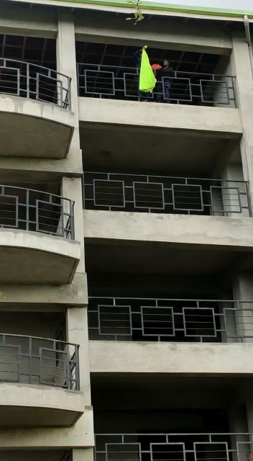
PARACHUTE TESTING
CLOTH PARACHUTE

Slide 5
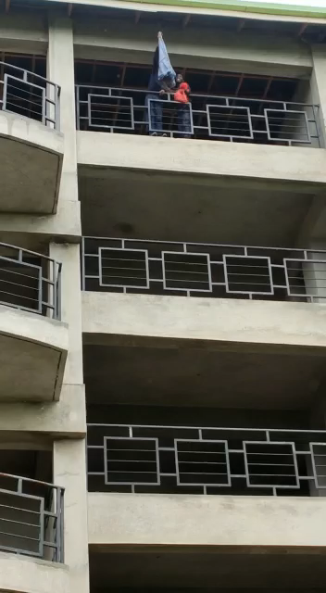
PARACHUTE TESTING
NYLON PARACHUTE

Slide 6
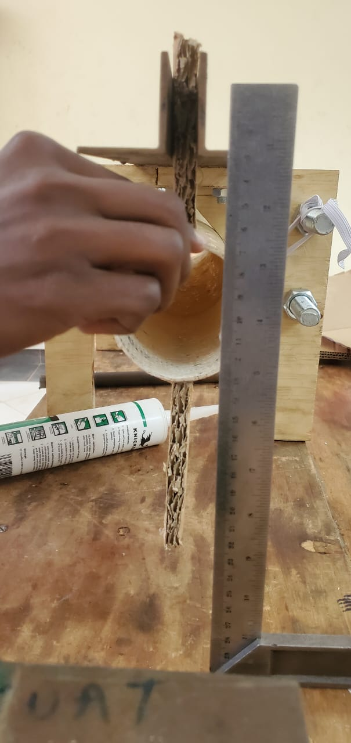
FIN FABRICATION
Prepared a fin template.
Preped a fin prototype from a card board Prepared the final fins from the carbon fiber

Slide 7
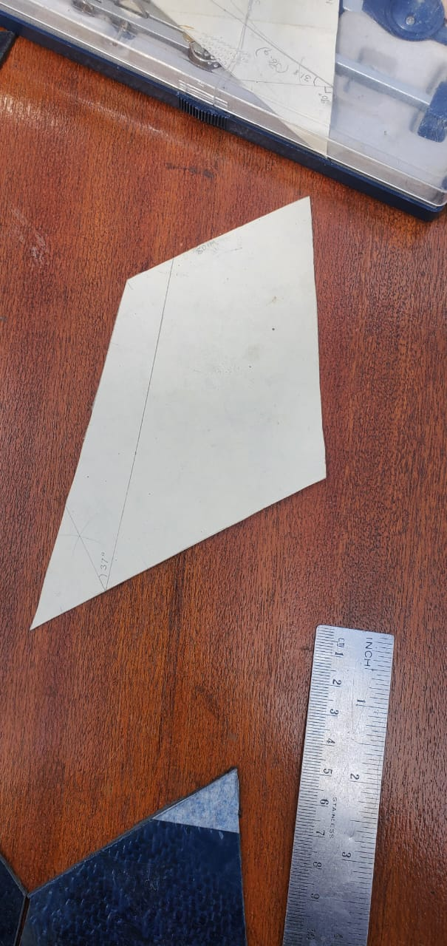
FIN TEMPLATE
Templates were cut from carton boxes
Wind tunnel test (currently unable to perform , technician unavailable)
Opted to perform CFD instead

Slide 8
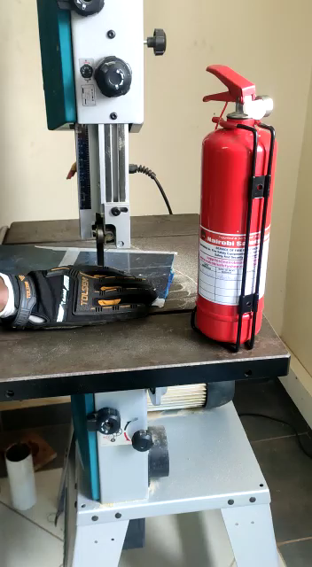
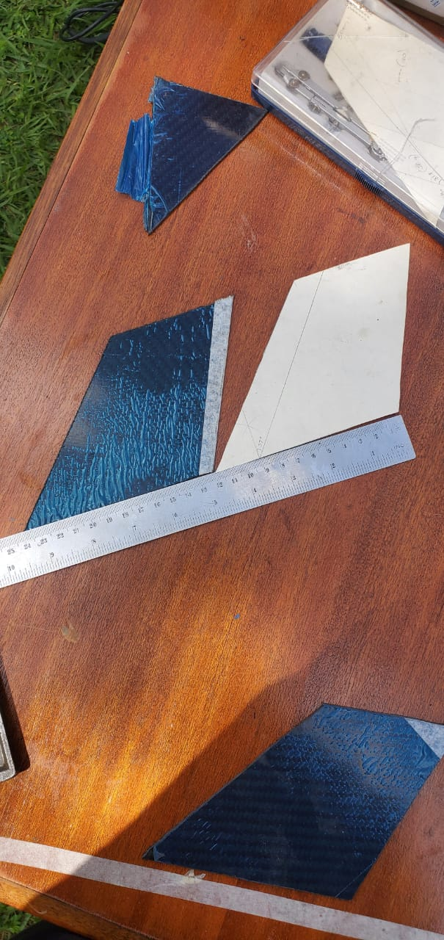
FIN FABRICATION
Cutting of the carbon fiber plate using the bench saw (Safety measures were observed)

Slide 9
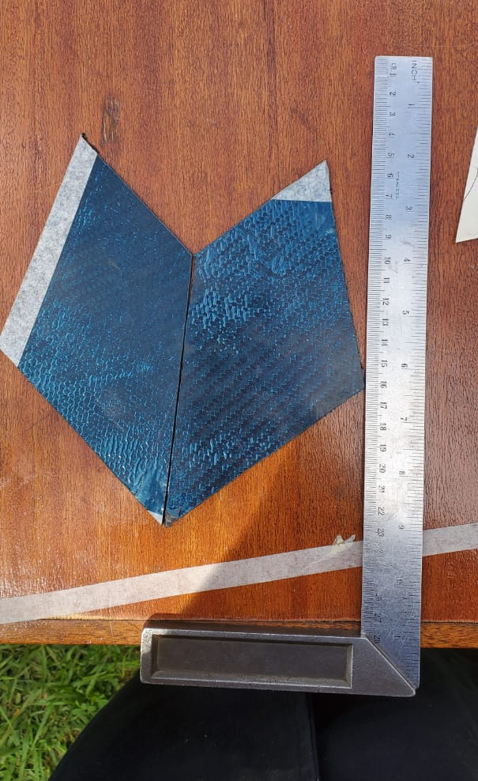
Final fin shape (trapezoidal shape, obtained from simulation on open rocket)

Slide 10
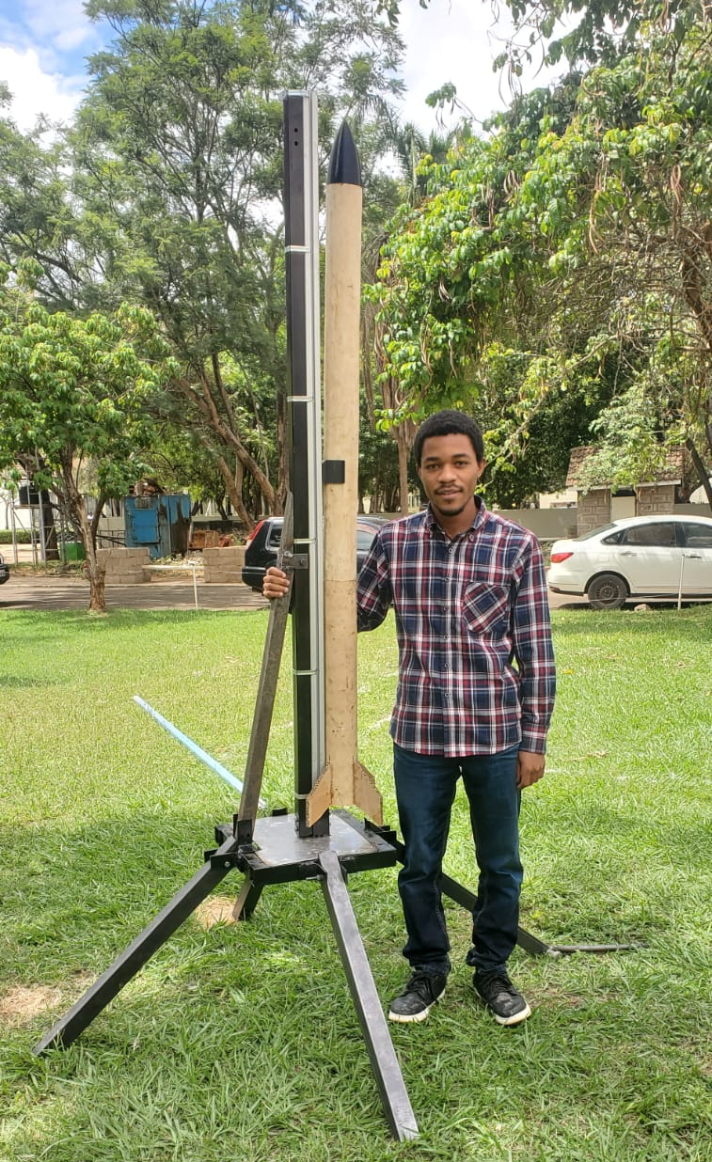
LAUNCH PAD
polishing and painting of the launch pad

Slide 11
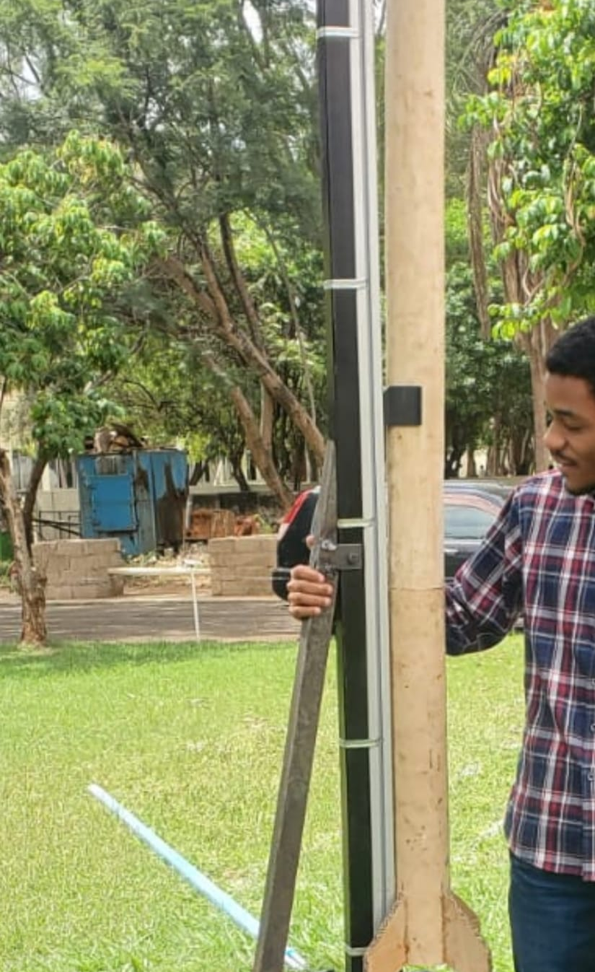
Launch pad with rocket attached to the rail

Slide 12
NEXT WEEK’S OBJECTIVES
Fin Attachment on the airframe
Motor Mount design and fabrication
Rocket Bend Test
Polishing and painting
Completion of Parachute Test

Slide 13
Q/A
THANK YOU!

